Slide 1
Introduction to philosophy Lecture 4
PHI1101
Dr. Lucas Scripter
Lecturer in General Education
School of Humanities and Social Sciences
Chinese University of Hong Kong, Shenzhen

Slide 2

Three ways of conceiving of philosophy
Philosophy as a Way of Life
Philosophy as the Foundation of the Sciences
Philosophy as Conceptual Analysis

Slide 3
REVIEW

Slide 4


Philosophy as a way of life 1
Pierre Hadot’s idea of “philosophy as a way of life” includes four key aspects:
1. Goal of Philosophy:
Self-Transformation
2. Setting of Philosophy:
Practiced in a Group or School
3. Psychological Assumption:
Philosophical training can lead to a change in human beings.
4. Metaphysical Context:
Philosophers should cultivate ‘cosmic consciousness’

Slide 5
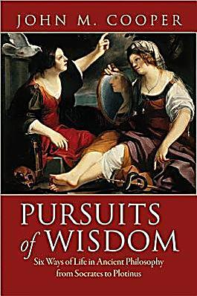
Philosophy as way of life 2
John M. Cooper (2012) has also argued that ancient philosophy is best understood as a ‘way of life’, but he emphasizes something different than Hadot.
“To live a life of philosophy is to live committed to following philosophical reason wherever it may lead. The promise is that by doing so—but only by doing so—one will achieve the best possible human life” (p. 18)
5. Living according to Reason
Conducing one’s life according to reason (not custom or religion)

Slide 6
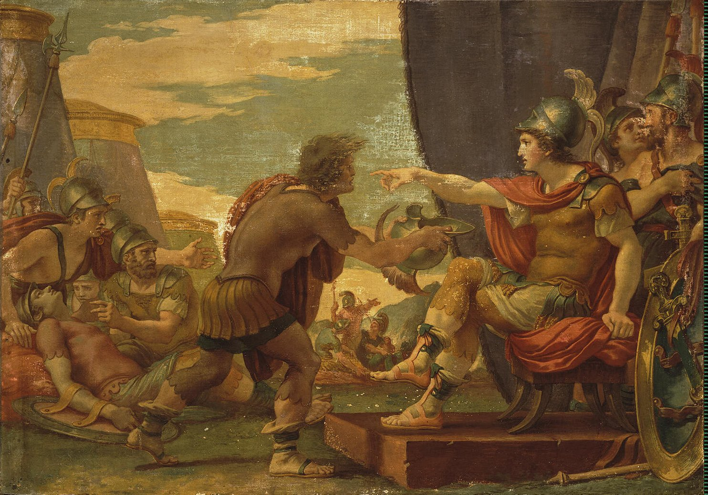
Hellenistic philosophy: the empire & the wise man
The conquests of Alexander the Great (356-323 BCE) brought about an end to the Greek city state system and the beginning of a Hellenistic empire.
Philosophy’s New Role in New Political Environment:
“In the great centralized state of which he was now a subject, the citizen of the old small city asked himself what attitude he should take up; he felt lost. Then he turned upon himself, considered his inner salvation, asked to be told what was the object of life, to be given an ideal in pursuing his own happiness. The ideal might be different in every school, but it would always be the ideal of the Wise Man, who belongs to no age or country; all would conceive him in the same resolutely pragmatic spirit” (Robin, p. 313, italics mine).

Slide 7
Hellenistic schools
Plato’s Academy
Aristotle’s Lyceum
The Cynics
The Skeptics
The Epicureans
The Stoics

Slide 8
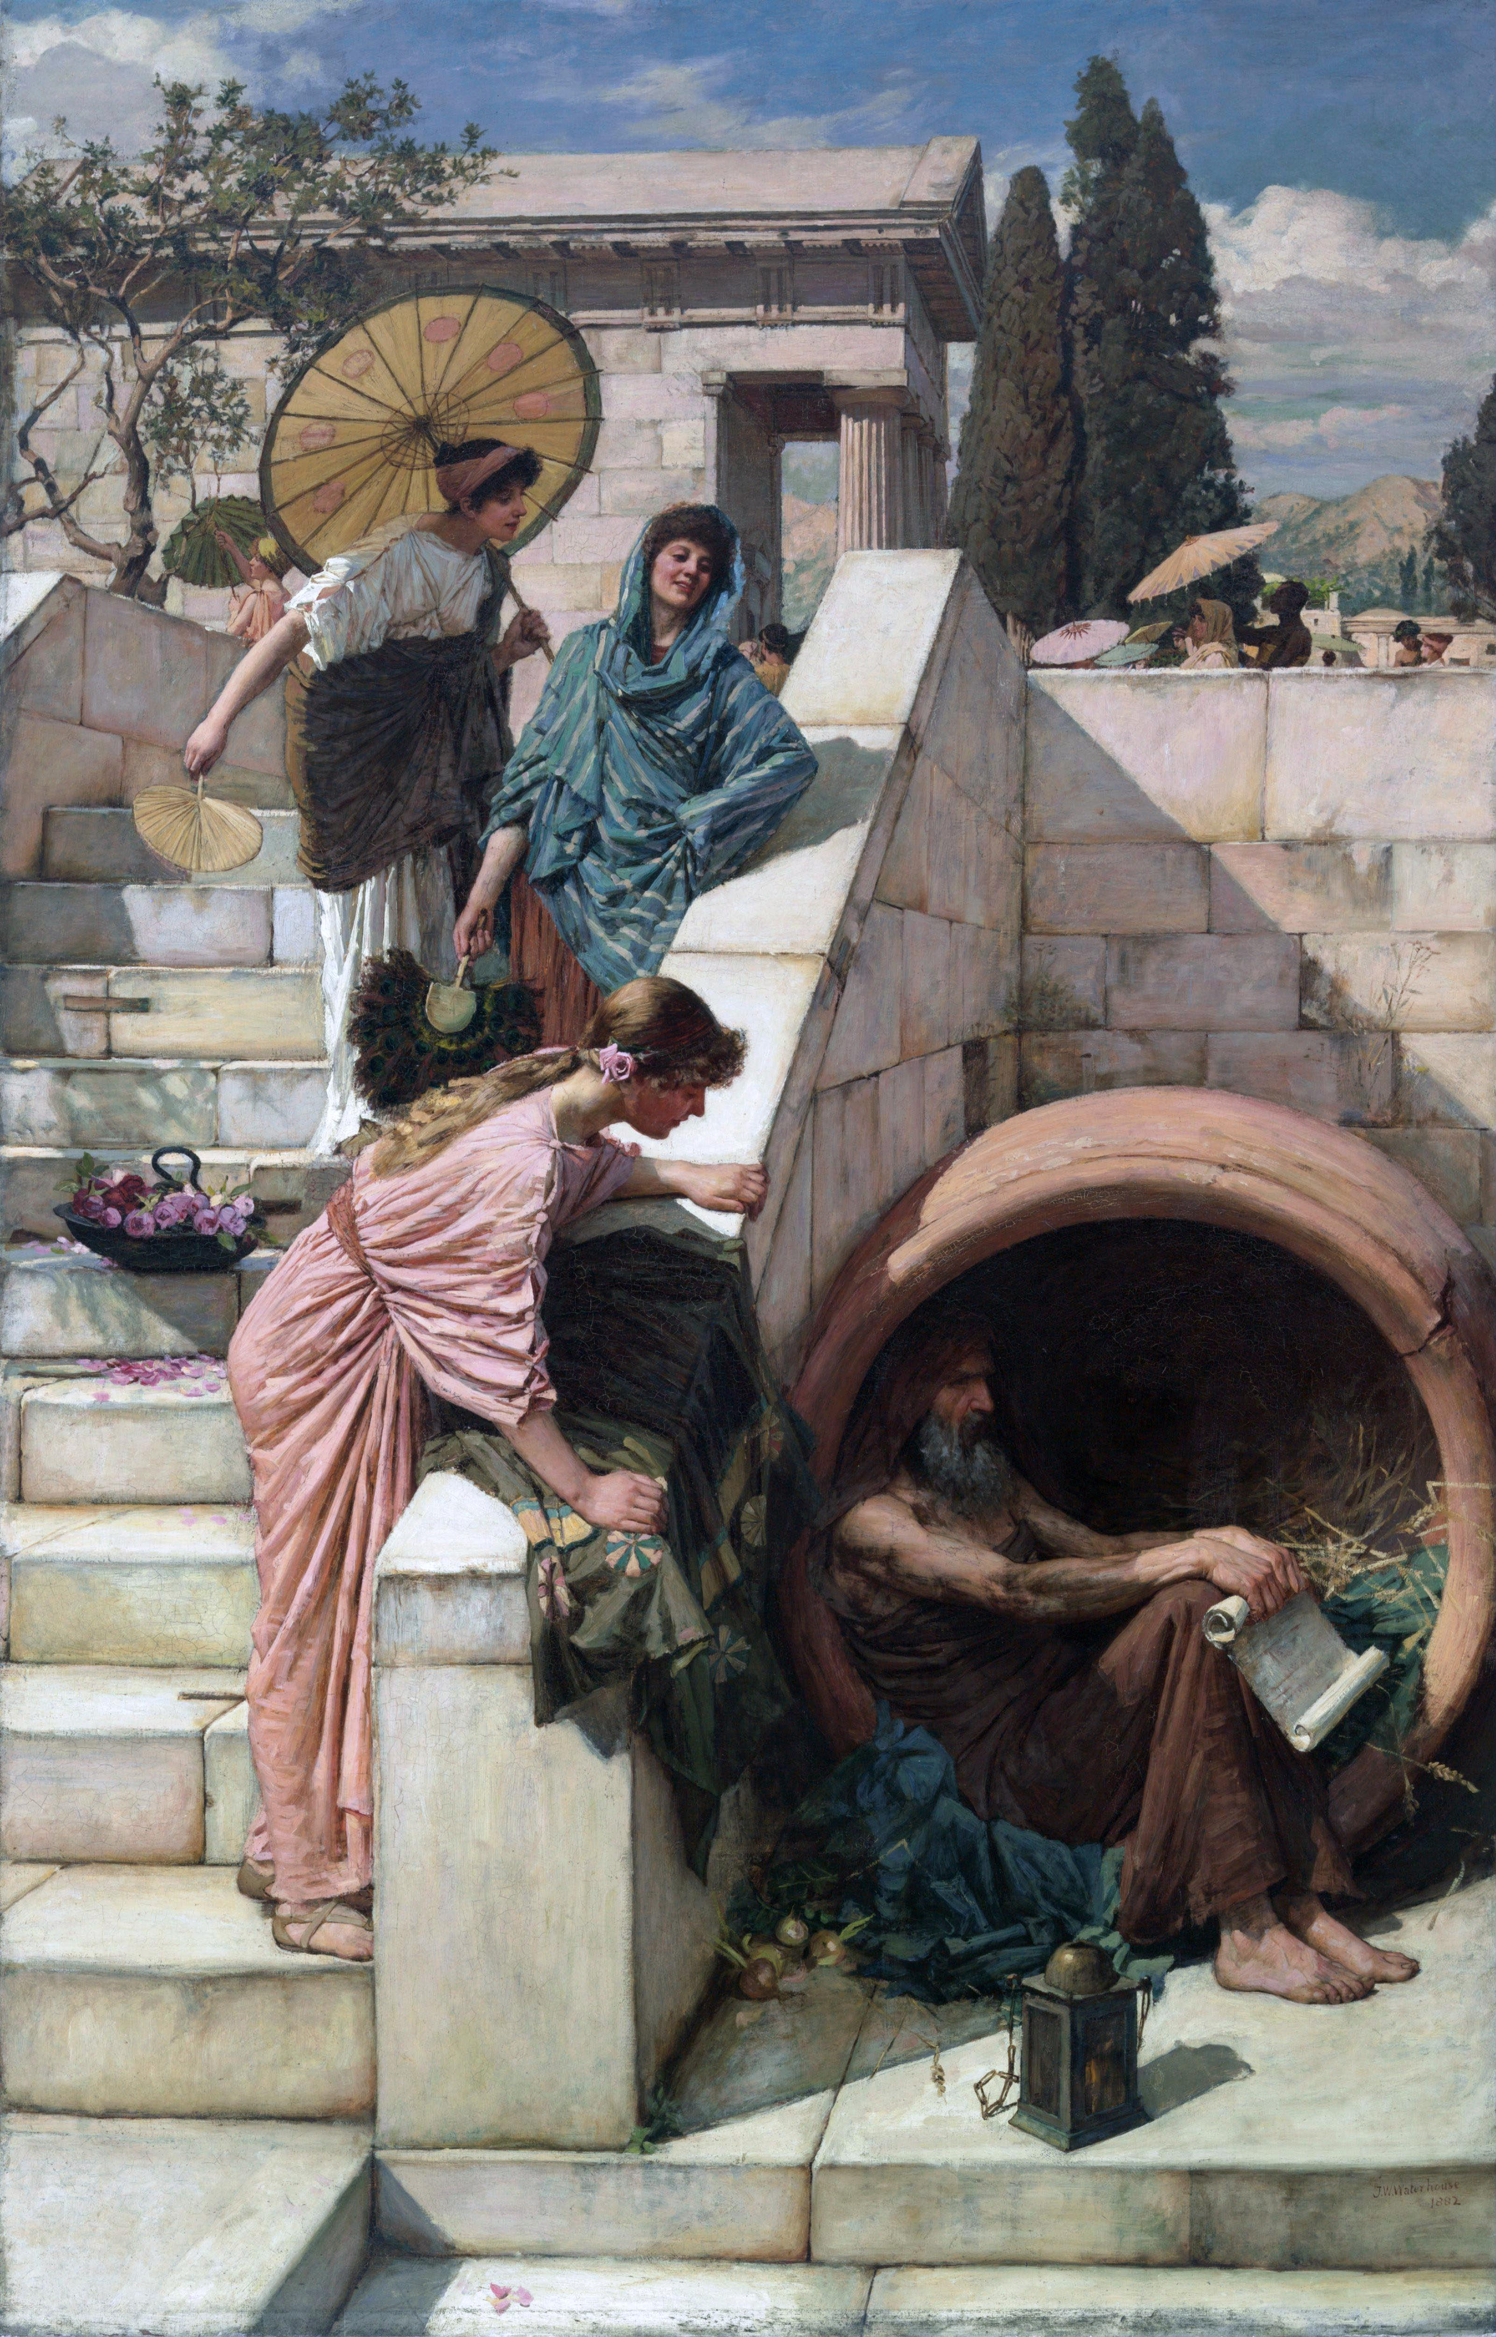
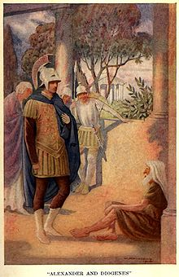
The cynics
The Cynics criticized social convention (nomos) and urged a return to nature (physis). The happy life was seen as following the way of nature like animals or children.
Among the most famous philosophers was Diogenes the Cynic, who lived in a barrel in Athens and engaged in unconventional behavior. There are no surviving writings from him.

Slide 9
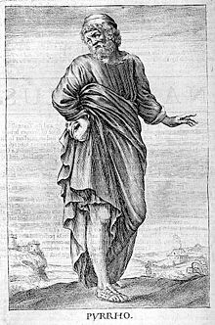
The skeptics (pyrrhonism)
The Skeptics were a school of ancient philosophy that sought happiness in indifference and suspension of judgment.
According to the Skeptics, philosophical belief was disruptive to peace of mind.
To combat this, the skeptics developed argumentative techniques designed to bring the mind to an equilibrium of arguments for and against resulting in a suspension of belief called epoche.

Slide 10
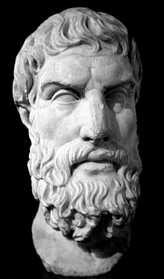
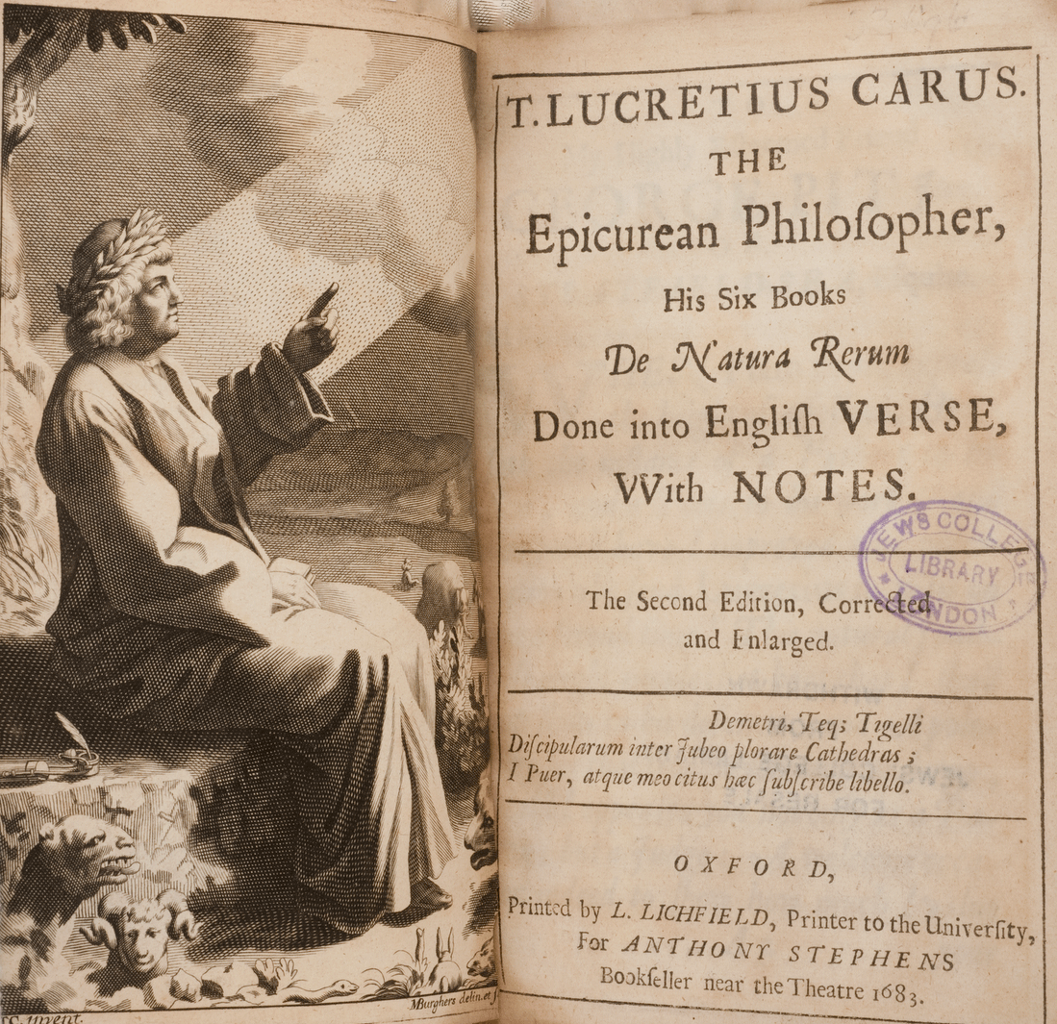
The epicureans
Epicurean philosophers offered a hedonistic moral philosophy combined with an atomistic metaphysics.
Pleasure
Happiness
Epicurus (341-270 BCE)
Lucretius (99-55 BCE)

Slide 11
Two kinds of Pleasure
Pleasure from Movement
Pleasure without Movement
Unstable pleasures that create for highs and lows. These pleasures are mixed with pains.
Stable pleasure from the healthy state of being without physical or mental pains.
Example: pleasures of luxurious food and drink; sexual activity
Example: pleasures of simple living and relaxation.
(see Cooper, pp. 229-246)

Slide 12
Epicurean theory of desires
Desires
Natural
Unnatural
Necessary
Unnecessary

Slide 13
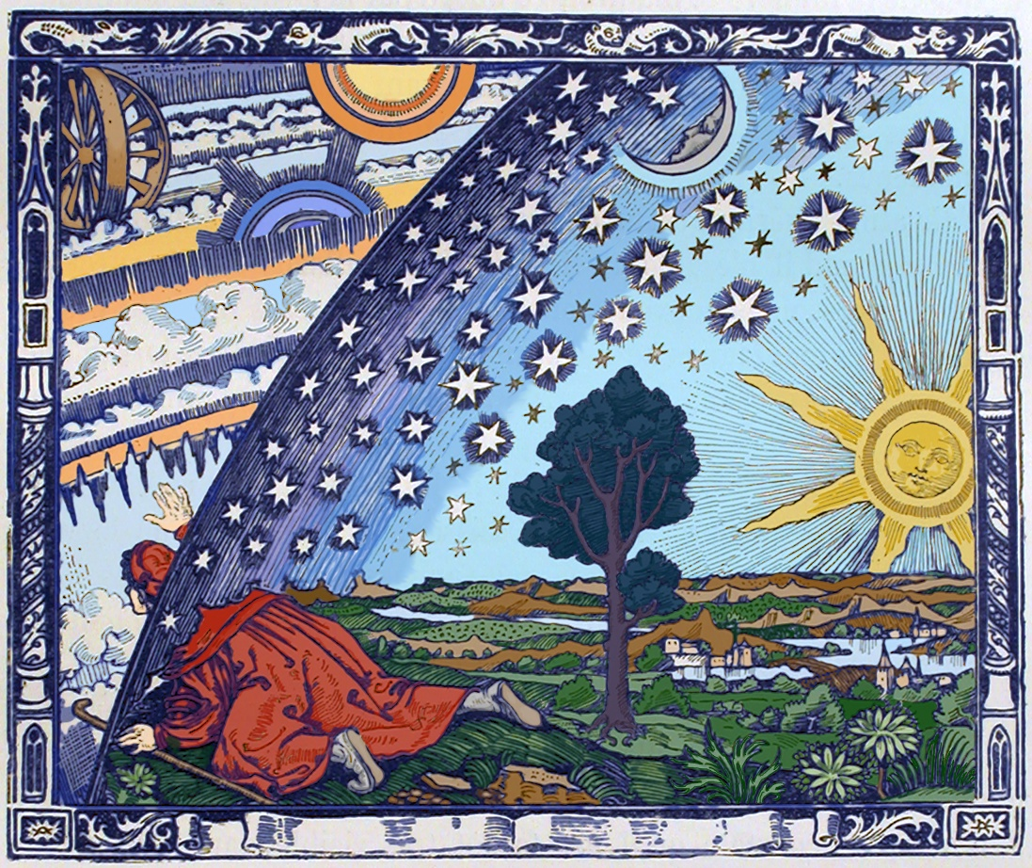
Atomistic view of nature
The Epicureans offer an atomistic view of natural for the sake of achieving tranquility.
Epicurean metaphysics: all things are composed of irreducible atoms in a void. Bodies are the result of collisions between atoms. These compose not only our bodies but whole worlds. The Epicureans believed in an infinite number of worlds.
The human body has soul (fine particles) dispersed within it.

Slide 14
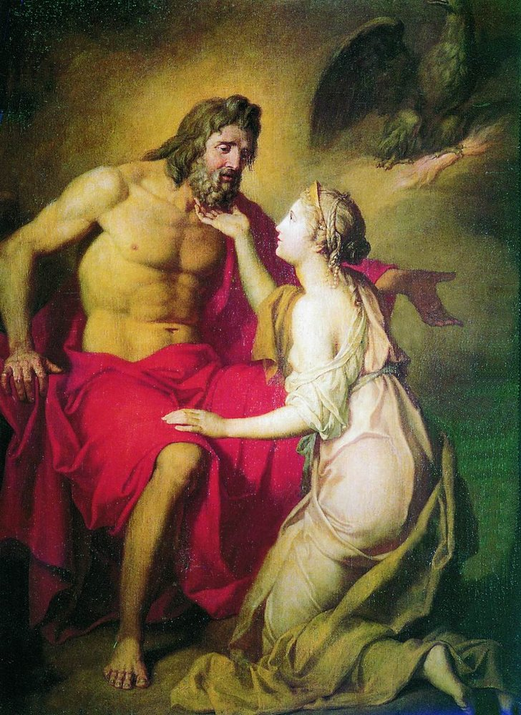
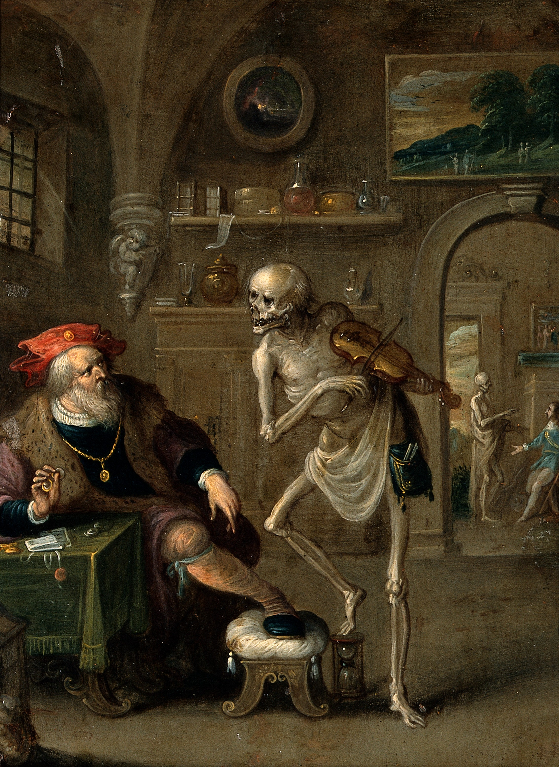
Overcoming two sources of fear
The gods
Death

Slide 15
stoicism

Slide 16
major stoic philosophers
Zeno
(334-262 BCE)
Chrysippus
(296-206 BCE)
Seneca
(4-65 CE)
Marcus Aurelius
(121-180 CE)
Epictetus
(55-135 CE)

Slide 17
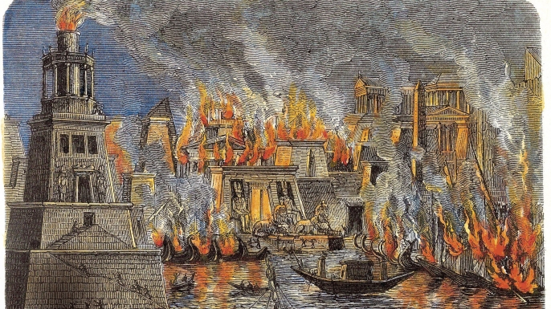
Two Challenges
According to John Cooper (2012, pp. 147-150), there are two challenges in discussing the Stoics in comparison with other major ancient philosophers.
It is a long tradition rather than just a single major philosopher.
We have little textual material from the earliest stoic philosophers. Our knowledge of Zeno and Chrysippus comes from summaries or quotations in other ancient sources, including those philosophers seeking to refute stoicism.

Slide 18

Stoic cosmology

Slide 19

Stoic pantheism 1: god as generating & destroying fire
The Stoics held the universe to be god understood as a fire that both creates and destroys the world in endless cycles.
“(1) The stoics made god out to be intelligent, a designing fire which methodically proceeds towards creation of the world, and encompasses all the seminal principles according to which everything comes about according to fate, (2) and a breath pervading the whole world, which takes on different names owing to the alternations of the matter through which it passes.” (Aetius 1.4.33 in Long and Hedley 46A)

Slide 20


Cycle of conflagrations

Slide 21

Eternal recurrence
The Stoics held the eternal recurrence of the world.
“Chyrsippus…when speaking of the world’s renewal, drew the following conclusion: ‘Since this is so, it is evidently not impossible that we too after our death will return again to the shape we now are, after certain periods of time have elapsed.” (Lactantius in Long and Sedley 52B)
“So always bear in mind these two points: firstly that all things are alike in nature from all eternity and recur in cycles, and it therefore makes no difference whether one sees the same spectacle for a hundred years or two hundred or for time everlasting; and secondly that the longest-lived and earliest to die suffer an equal loss; for it is solely of the present moment that each will be deprived, if it is really the case that this is all he has and a person cannot lose what he does not have.” (Aurelius, Meditations, 2.14, italics mine)

Slide 22

Stoic pantheism 2: god as singular organism
The Universe as a Single Living, Harmonious Organism:
“Constantly think of the universe as a single living being, comprised of a single substance and a single soul; and how all things issue into the single perception of this being, and how it accomplishes all things through a single impulse; and how all things work together to cause all that comes to be, and how intricate and densely woven is the fabric formed by their interweaving.” (Aurelius, Meditations, 4.40)

Slide 23
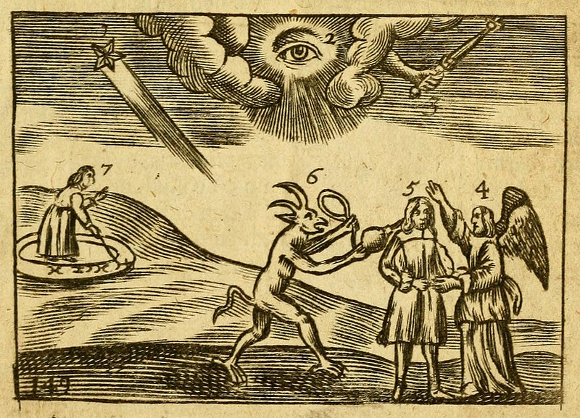
stoic pantheism 3: god’s rational providence
God as supremely rational, perfect and providential world-order.
“They [the Stoics] say that god is an animal which is immortal and rational or intelligent, perfect in happiness, not admitting of any evil, provident towards the world and its occupants, but not anthropomorphic. He is the creator of the whole and, as it were, the father of all, both generally and, in particular, that part of him that pervades all things, which is called by many descriptions according to his powers…” (Diogenes Laertius 7.147 in Long and Hedley 54A.

Slide 24
Reason: cosmic & human
Human beings possess reason, the same principle that governs the whole world-soul.
“Revere the highest power in the universe, the power that makes use of all things and presides over all. And likewise, revere the highest power in yourself: and this power is of one kind with the other. For in yourself too, this is what makes use of everything else, and your life is governed by it.” (Aurelius, Meditations 5.21)
Rational
World-Soul
Human Reason

Slide 25
Comparison: Stoic & epicurean cosmologies
Epicurean
Atomistic
Stoic
Organic
Vitalistic
Mechanical
Infinite Worlds
One World-Soul
Accidental
Purposeful
Pantheistic
Functionally Atheistic
(see Robin, p. 341; Hadot 2004, pp. 129-130)

Slide 26
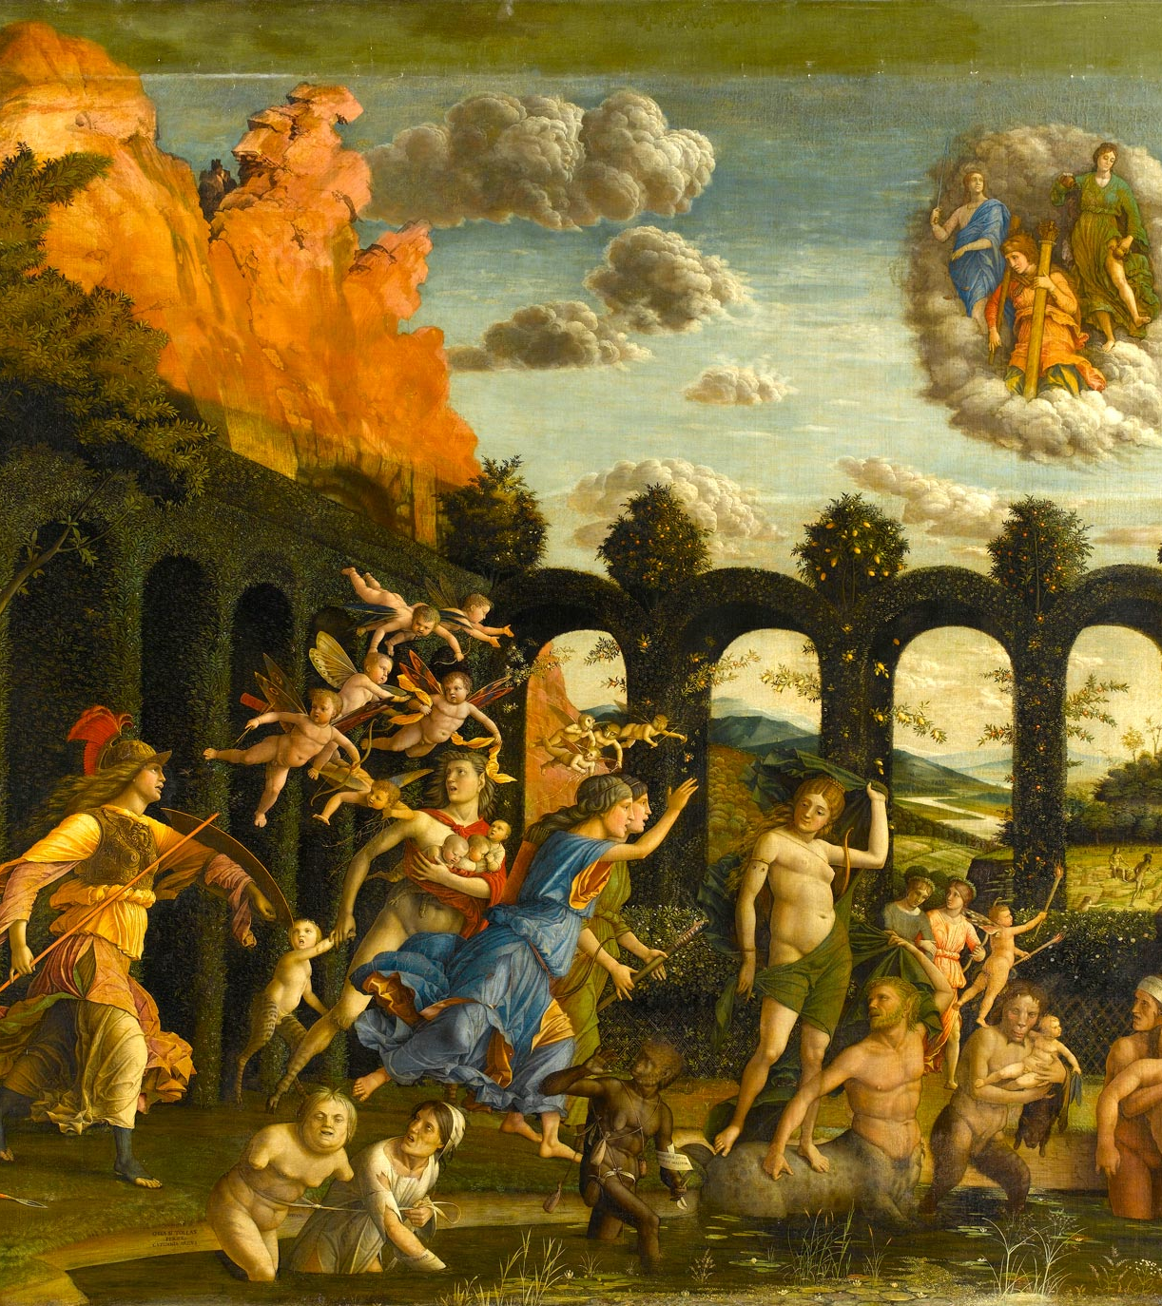
Stoic practical philosophy

Slide 27
Stoic happiness as virtue
Virtue
Happiness

Slide 28
Key distinction
“Some things are within our power, while others are not. Within our power are opinion, motivation, desire, and, in a word, whatever is of our own doing; not within our power are our body, our property, reputation, office, and, in a word, whatever is not our own doing.” (Epictetus, Handbook 1.1)
In Our Power
Not In Our Power
Our Doings
Opinion
Motivation
Desire
Not Our Doing
Property
Our body
Reputation/Social Standing

Slide 29
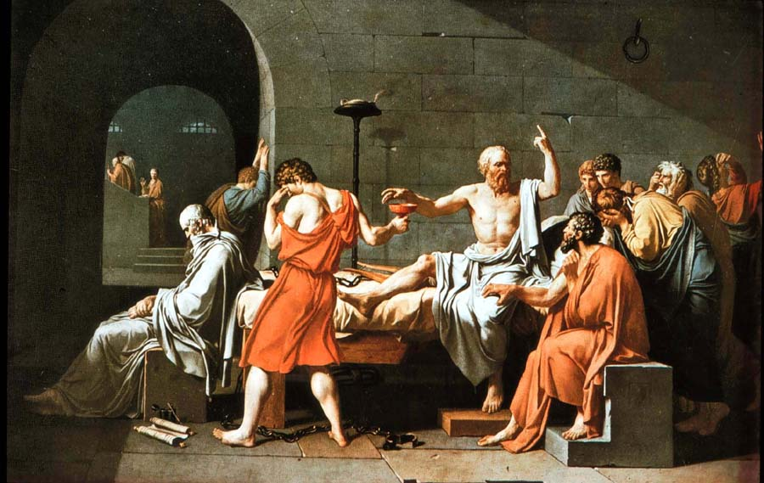
What can harm us?
The Stoics hold that the only things that can genuinely be good or bad for us concern the states of our own minds.
External happenings cannot really make us better or worse.
“The condition and character of a layman is this: that he never expects that benefit or harm will come to him from himself, but only from externals. The condition and character of a philosopher is this: that he expects all benefit and harm to come to him from himself.” (Epictetus, Handbook 48.1)
“Whoever does wrong, wrongs himself; whoever acts unjustly, acts unjustly towards himself because he makes himself bad.” (Aurelius, Meditations 9.4)

Slide 30
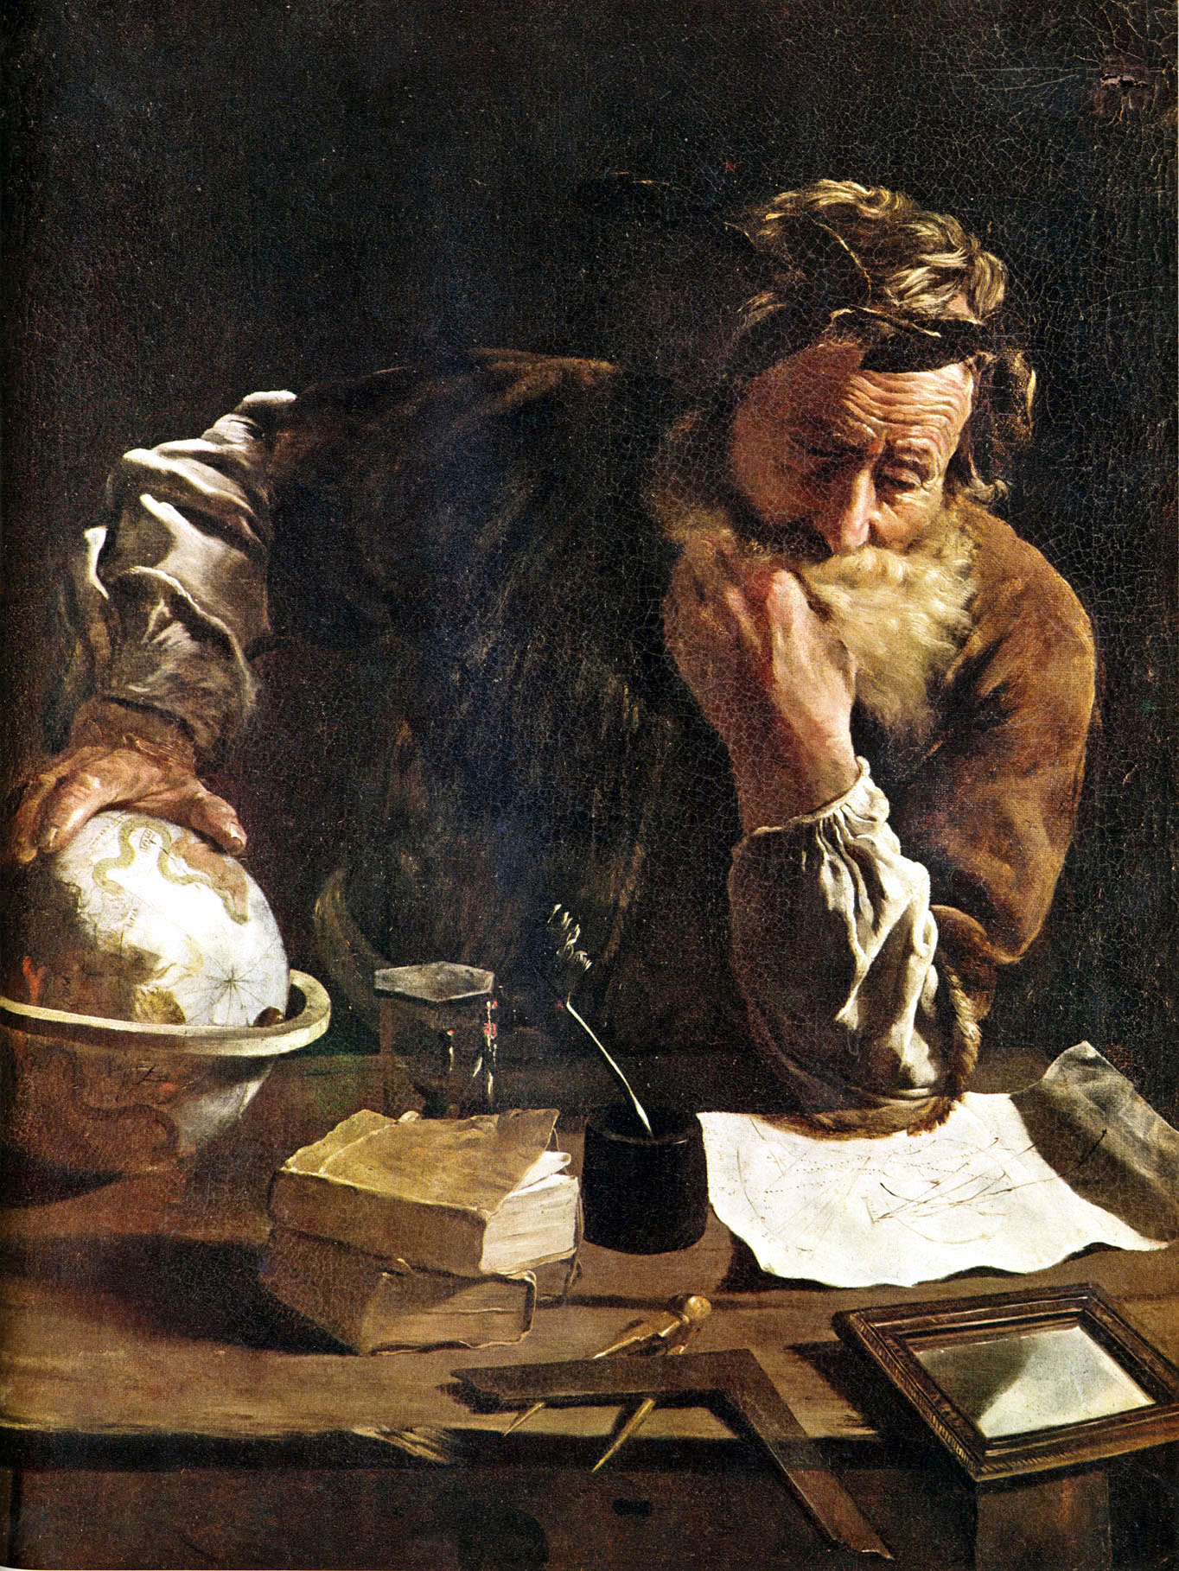
Virtue as happiness
“What is a happy life? Peacefulness and constant tranquility. Loftiness of mind will bestow this, and consistency which holds fast to good judgment. How are these things reached? If all truth has been seen, if orderliness, moderation, and seemliness are preserved in actions, and a will which is guiltless and kindly, focused upon reason and never departing from it, as loveable as it is admirable. To put in a nutshell for you, the wise man’s mind should be as befits god.” Seneca in Long and Sedley 63F.

Slide 31

Harmony with Nature
The Stoics urged that one ought to live in harmony with the universe. This meant several things:
Internal Harmony of the Self
Seeing the self as in harmony with the purposes of the world-mind; accepting fate.
“No one can prevent you from living according to the rule of your own nature and nothing can happen to you which is contrary to the rule of universal nature.” (Aurelius, Meditations 6. 58)
Looking to nature for guidelines on how to live.
(See Cooper, pp. 151-154)

Slide 32
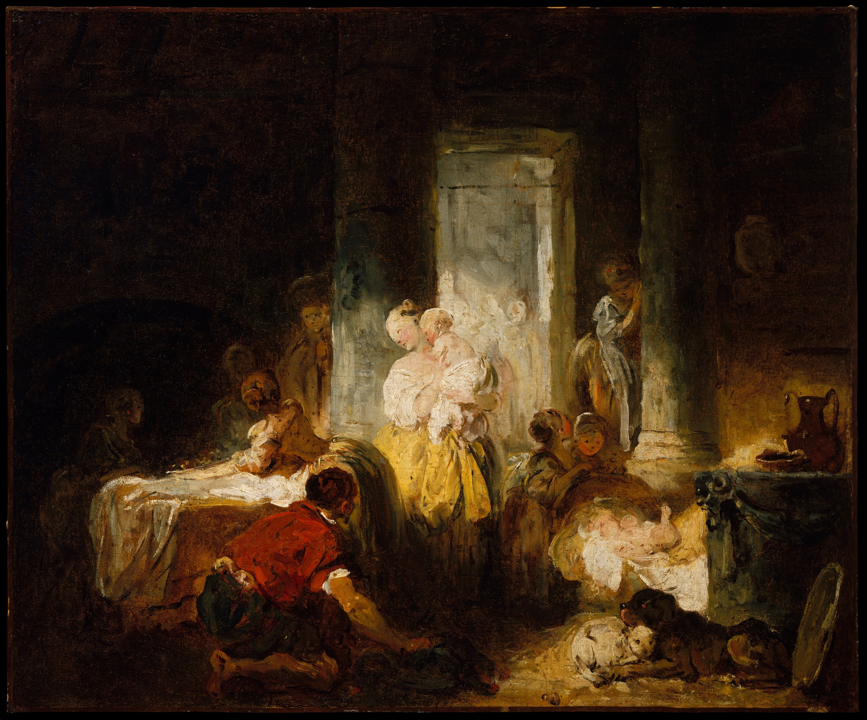
Natural duties
The Stoics believed that we should look to nature (specifically our nature as a rational, social creature) as a source of our duties or which actions are ‘appropriate.’
“Appropriate actions are measured on the whole by our social relationships…you’ll discover the appropriate actions to expect from a neighbor, from a fellow citizen, from a general, if you get into the habit of examining your social relationships.” (Epictetus, Handbook 30)
(see Hadot 2004, pp. 133-134; Cooper, pp. 153-4)

Slide 33
It is our judgments that bother us
“It isn’t the things themselves that disturb people, but the judgments that they form about them. Death, for instance, is nothing terrible, or else it would have seemed so to Socrates too; no, it is in the judgment that death is terrible and the terror lies.” (Epictetus, Handbook 5)
“When you see someone weeping in sorrow…be ready at once with this thought ‘It isn’t what has happened that so distresses this person—for someone else could suffer the same without feeling the distress-but rather the judgment that he has formed about it.’” (Epictetus, Handbook 16)

Slide 34

Stoic theory of emotion
The stoics hold that our emotions or passions are judgments of situations.
Our negative emotions flow from faulty judgments of what counts as a genuine good or evil.
By correcting our judgments, we can free ourselves from negative emotions.

Slide 35
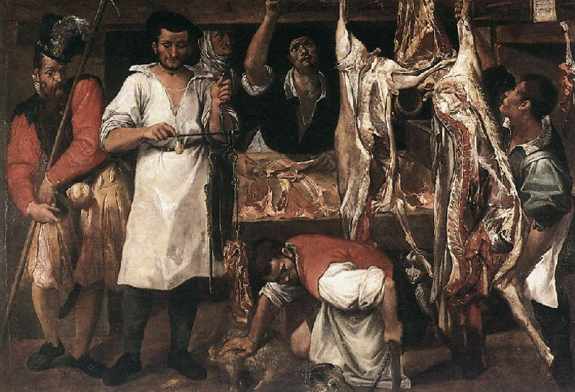
The Practice of correcting our judgments
The Stoics used certain techniques of re-describing desired objects in a way that showed ‘the things themselves’ and helped the practitioner to overcome the passions.
“When you have savouries and fine dishes set before you, you will gain an idea of their nature if you tell yourself that this is the corpse of a fish, and that the corpse of a bird or a pig; or again, that fine…wine is merely grape-juice, and this purpose robe some sheep’s wool dipped in the blood of a shellfish; and as for sexual intercourse, it is the friction of a piece of gut and, following a sort of convulsion, the expulsion of some mucus. Thoughts such as these reach through to the things themselves and strike to the heart of them, allowing us to see them as they truly are.” (Aurelius, Meditations 6, 13; see Hadot 2004, pp. 135ff.)

Slide 36
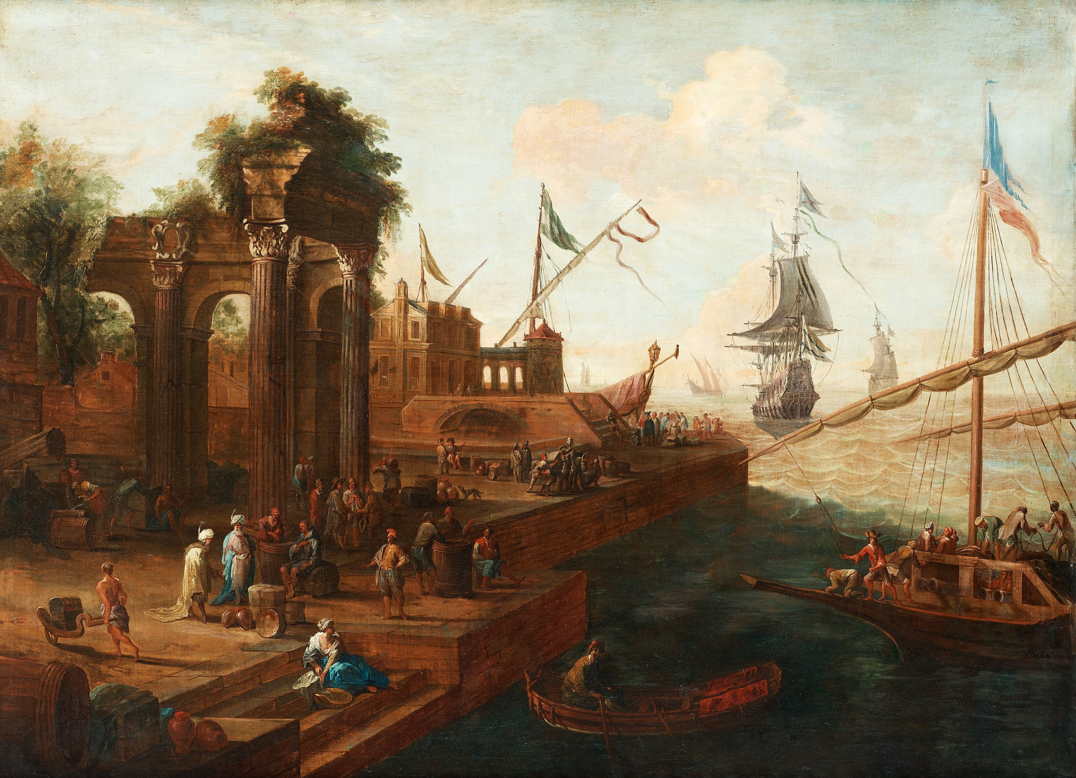
Ship analogy
“When you’re on a voyage and your ship has set anchor, if you should go ashore to fetch water, you may pick up a little shellfish or bulb along the way, but you have to keep your attention directed towards the ship, and turn round constantly in case the captain calls you back; and if he does, you must cast these things aside, if you don’t want to be thrown on board trussed like a sheep. So in life too, if in place of some little bulb or shellfish, a little wife or child should be granted to you, there is nothing wrong with that; but if the captain calls you must give up all these things and run to the ship, without even turning around to look back. And if you’re an old man, you shouldn’t even wander any distance from the ship, so as not to be missing when the call comes.” Epictetus, Handbook 7)

Slide 37
Banquet analogy
“Remember that you should behave in life as you do at a banquet. Something is being passed around and arrives in front of you: reach out your hand and take your share politely. It passes: don’t try to hold it back. It has yet to reach you: don’t project your desire towards it, but wait until it arrives in front of you. So act likewise with regard to your children, to your wife, to public office, to riches, and the time will come when you’re worthy to have a seat at the banquets of the gods. And if you don’t even take these things when they’re in front of you, but view them with contempt, then you’ll not only share in the banquets of the gods, but also in their rule.” Epictetus, Handbook 15

Slide 38
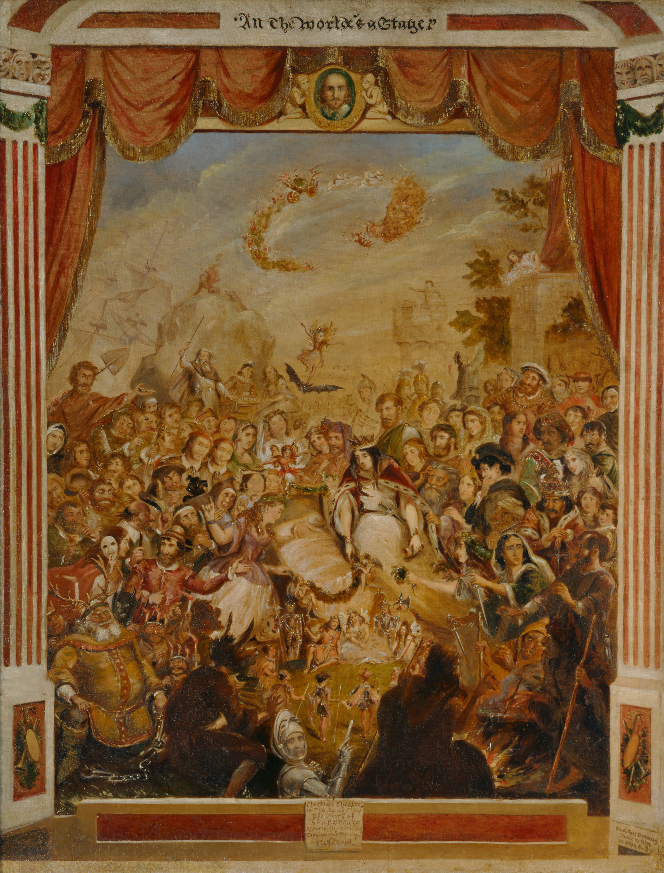
Actor analogy
“Remember that you’re an actor in a play, which will be as the author chooses, short if he wants it to be short, and long if he wants it to be long. If he wants you to play the part of a beggar, act even that part with all your skill, and likewise if you’re playing a cripple, an official or a private citizen. For that is your business, to act the role that is assigned to you as well as you can; but it is another’s part to select that role.” (Epictetus, Handbook 17)

Slide 39
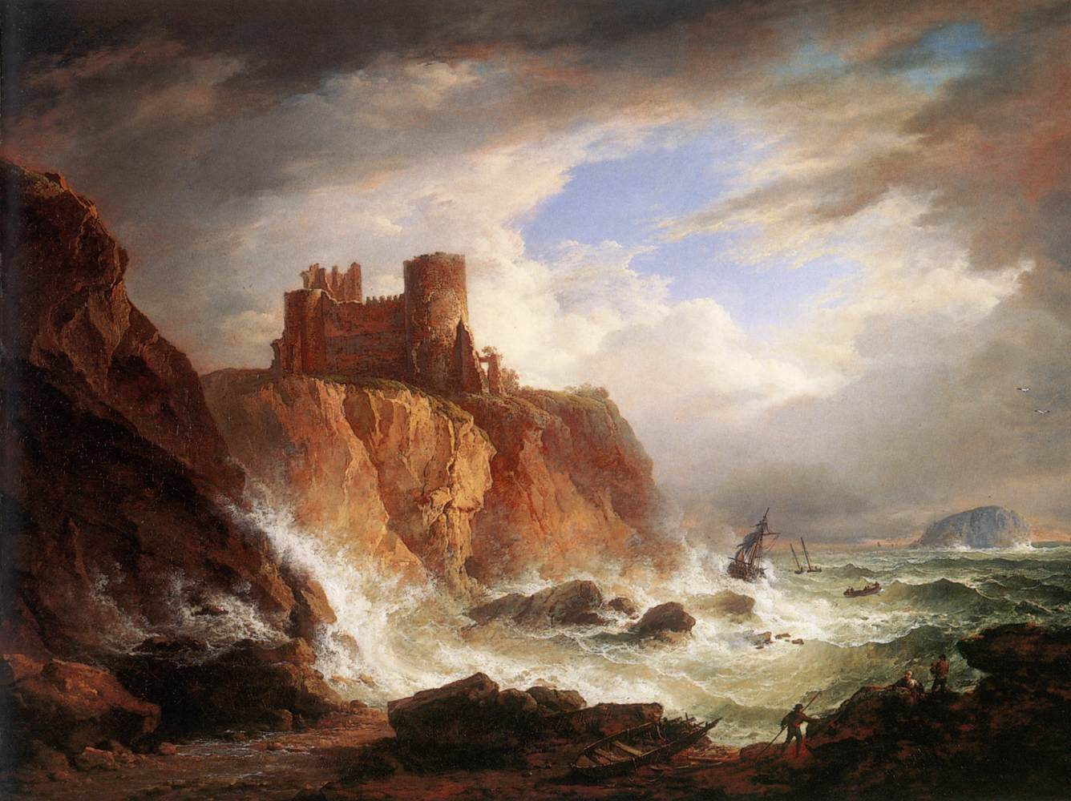
Invincibility of our ruling citadels
“Remember that your ruling center becomes invincible when it withdraws into itself and rests content with itself, doing nothing other than what it wishes, even where its refusal to act is not reasonably based; and how much more contented it will be, then, when it founds its decision on reason and careful reflection. By virtue of this, an intelligence freedom from passions is a mighty citadel; for man has no stronghold more secure to which he can retreat to remain unassailable form that time onward.” (Aurelius, Meditations 8.48)

Slide 40
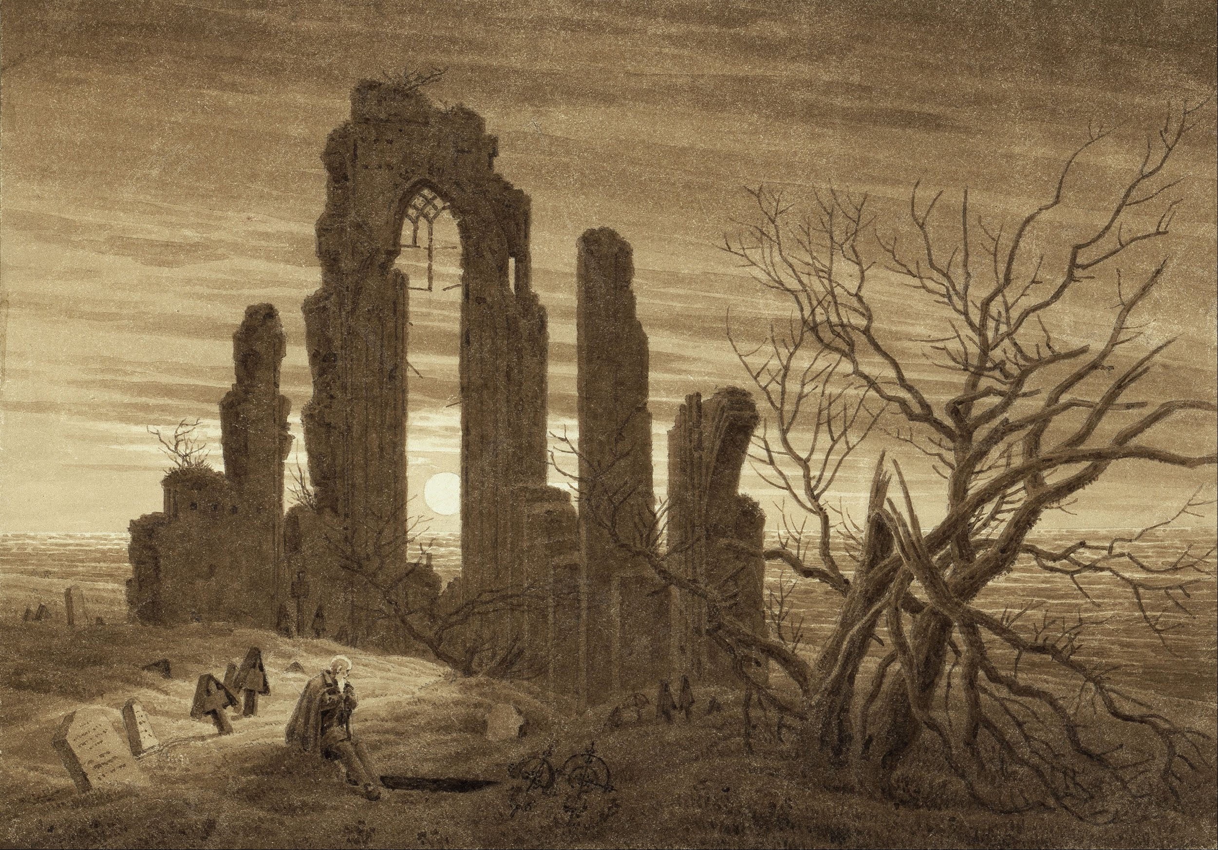
Against the fear of death
Against the fear of death, the stoics emphasized our place within the fatalistic order of the ever-changing world-soul:
“What has died does not fall out of the universe: and if it remains here, it is also transformed here and resolved into its own constituents which are the elements of the universe and of yourself. And these elements themselves are transformed and utter no complaint.” (Aurelius, Meditations 8.18.

Slide 41

Living in the present
“Do not disturb yourself by picturing your life as a whole; do not assemble in your mind the many and varied troubles which have come to you in the past and will come again in the future, but ask yourself with regard to every present difficulty: ‘What is there in this that is unbearable and beyond endurance?’ You would be ashamed to confess it! And then remind yourself that it is not the future or what has passed that afflicts you, but always the present…” (Aurelius, Meditations 8. 36)

Slide 42
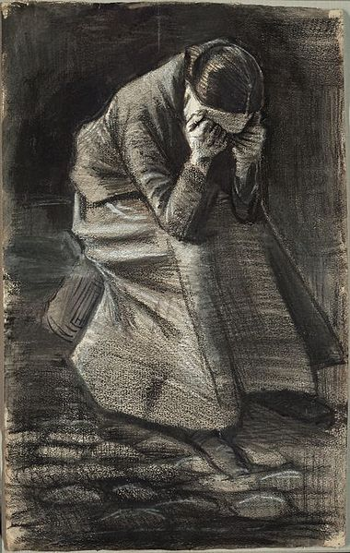
Stoic tranquility?
“If you kiss your child or your wife, say to yourself that it is a human being you’re kissing; then then, if one of them should die, you won’t be upset.” (Epictetus, Handbook 3).

Slide 43
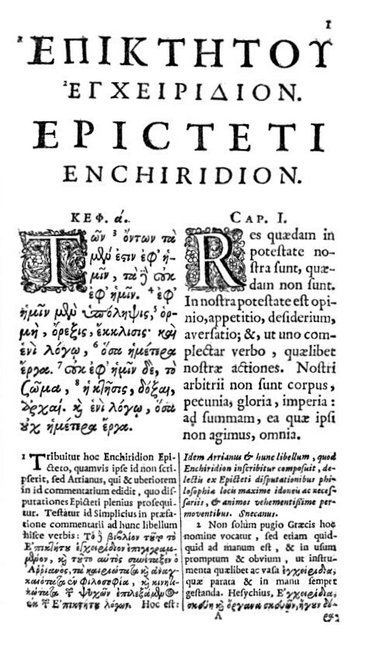
Stoic secret to happiness
“Don’t seek that all that comes about should come about as you wish, but with that everything that comes about should come about just as it does, and then you’ll have a calm and happy life.” (Epictetus, Handbook 8)

Slide 44
Comparison: three ancient views of happiness
Epicurean
Happiness: Pleasure.
Aristotelian
Happiness: Virtue & External Goods
Virtue as the realization of reason in contemplation and controlling our irrational appetites.
Stoic
Happiness: Virtue alone.
Virtue is understood as rational self-government—forming the right judgments.
Lasting pleasure is to be found in stable (non-movement based) sources, both psychic and material
Human happiness is vulnerable to luck and external happenings.
Human happiness is always within our grasp and is immune to luck.
(see Cooper, pp. 191-2, 203ff)

Slide 45
A Critique of invulnerabilism

Slide 46

Todd May on human vulnerability
Is it really good be rendered invulnerable? Is that humanly desirable? Do we lose something?
In his book A Fragile Life, Todd May (2017) argues that “invulnerabilist” philosophies like Epicureanism and Stoicism are wrong-headed, even if we can learn things from them.
We will discuss this line of critique in the tutorial.

Slide 47
Bibliography
Cooper (2012). Pursuits of Wisdom. Princeton.
Hadot (2004). What is Ancient Philosophy? Harvard UP.
Hadot (1998). Philosophy as a Way of Life. Blackwell.
Long and Sedley (1987). The Hellenistic Philosophers. Cambridge.
May (2017). A Fragile Life. Chicago.
Robin (1996). Greek Thought: And the Origins of the Scientific Spirit. Routledge.

